Slide 1


Desarrollo móvil Clase 4 – Navegación en Flutter
Pedro M. Wightman, Ph.D.

Slide 2

Agradecimientos
Este material está basado en los libros 'Flutter for Beginners' de Alessandro Biessek, 'Google Flutter 2 Cookbook' de Simone Alessandria y Brian Kayfitz y la documentación oficial de Flutter (https://flutter.dev/docs/)

Slide 3
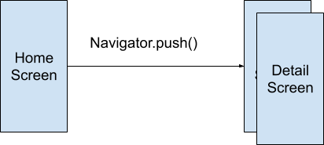
Navigator push
Cuando el método push() es llamado, el widget DetailScreen se coloca sobre el widget HomeScreen como en una pila
La ventana anterior (HomeScreen) aún existe en el árbol de widgets, así que cualquier objeto State asociado con ella sigue existiendo mientras DetailScreen está visible.

Slide 4
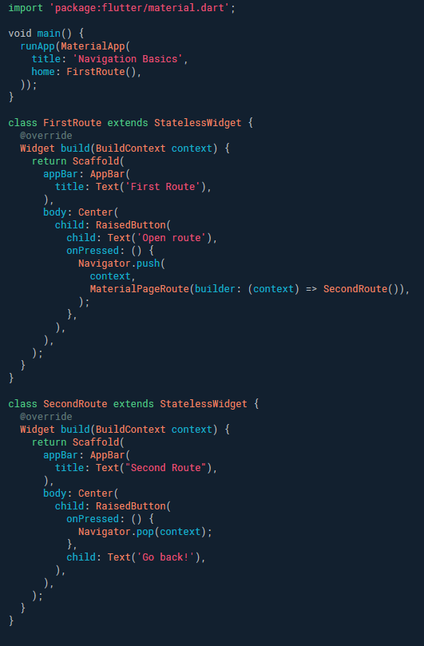
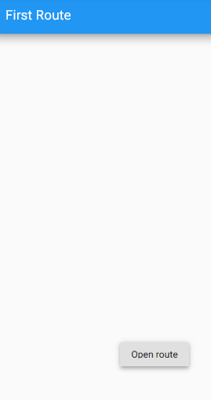
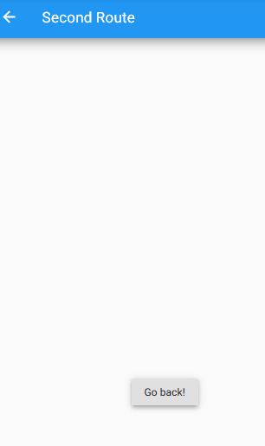
Navegación - Go and come back
Notes:
https://flutter.dev/docs/cookbook/navigation/navigation-basics
Code:
import 'package:flutter/material.dart';
void main() {
runApp(MaterialApp(
title: 'Navigation Basics',
home: FirstRoute(),
));
}
class FirstRoute extends StatelessWidget {
@override
Widget build(BuildContext context) {
return Scaffold(
appBar: AppBar(
title: Text('First Route'),
),
body: Center(
child: RaisedButton(
child: Text('Open route'),
onPressed: () {
Navigator.push(
context,
MaterialPageRoute(builder: (context) => SecondRoute()),
);
},
),
),
);
}
}
class SecondRoute extends StatelessWidget {
@override
Widget build(BuildContext context) {
return Scaffold(
appBar: AppBar(
title: Text("Second Route"),
),
body: Center(
child: RaisedButton(
onPressed: () {
Navigator.pop(context);
},
child: Text('Go back!'),
),
),
);
}
}

Slide 5
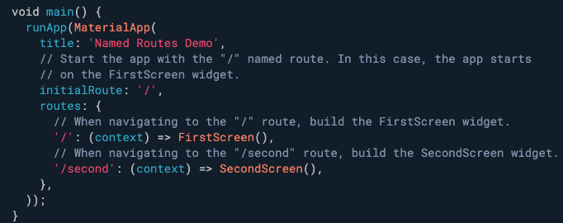
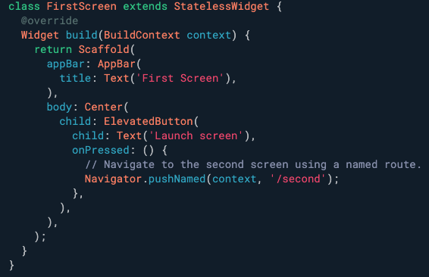
Navegación con rutas
Notes:
Code:
import 'package:flutter/material.dart';
void main() {
runApp(MaterialApp(
title: 'Named Routes Demo',
// Start the app with the "/" named route. In this case, the app starts
// on the FirstScreen widget.
initialRoute: '/',
routes: {
// When navigating to the "/" route, build the FirstScreen widget.
'/': (context) => FirstScreen(),
// When navigating to the "/second" route, build the SecondScreen widget.
'/second': (context) => SecondScreen(),
},
));
}
class FirstScreen extends StatelessWidget {
@override
Widget build(BuildContext context) {
return Scaffold(
appBar: AppBar(
title: Text('First Screen'),
),
body: Center(
child: ElevatedButton(
child: Text('Launch screen'),
onPressed: () {
// Navigate to the second screen using a named route.
Navigator.pushNamed(context, '/second');
},
),
),
);
}
}
class SecondScreen extends StatelessWidget {
@override
Widget build(BuildContext context) {
return Scaffold(
appBar: AppBar(
title: Text("Second Screen"),
),
body: Center(
child: ElevatedButton(
onPressed: () {
// Navigate back to the first screen by popping the current route
// off the stack.
Navigator.pop(context);
},
child: Text('Go back!'),
),
),
);
}
}

Slide 6
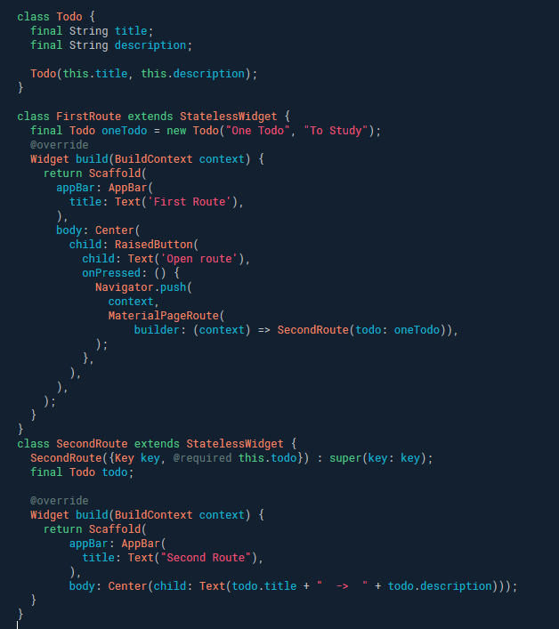
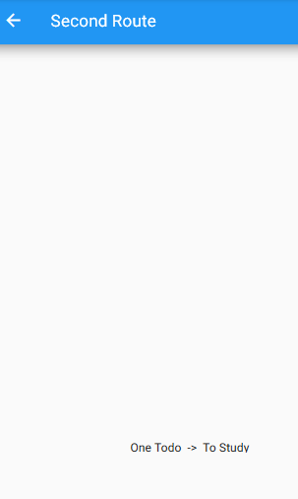
Navegación – Envío de parámetros
Notes:
https://flutter.dev/docs/cookbook/navigation/passing-data
Code:
import 'package:flutter/material.dart';
void main() {
runApp(MaterialApp(
title: 'Navigation Basics',
home: FirstRoute(),
));
}
class Todo {
final String title;
final String description;
Todo(this.title, this.description);
}
class FirstRoute extends StatelessWidget {
final Todo oneTodo = new Todo("One Todo", "To Study");
@override
Widget build(BuildContext context) {
return Scaffold(
appBar: AppBar(
title: Text('First Route'),
),
body: Center(
child: RaisedButton(
child: Text('Open route'),
onPressed: () {
Navigator.push(
context,
MaterialPageRoute(
builder: (context) => SecondRoute(todo: oneTodo)),
);
},
),
),
);
}
}
class SecondRoute extends StatelessWidget {
SecondRoute({Key key, @required this.todo}) : super(key: key);
final Todo todo;
@override
Widget build(BuildContext context) {
return Scaffold(
appBar: AppBar(
title: Text("Second Route"),
),
body: Center(child: Text(todo.title + " -> " + todo.description)));
}
}

Slide 7
Parametros con navegación usando rutas
Definir los argumentos que necesita pasar.
Crear un widget que extraiga los argumentos.
Registrar el widget en la tabla de rutas.
Navegar hacia el widget.

Slide 8
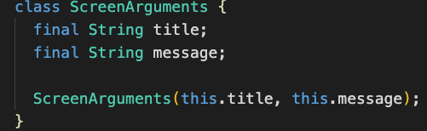
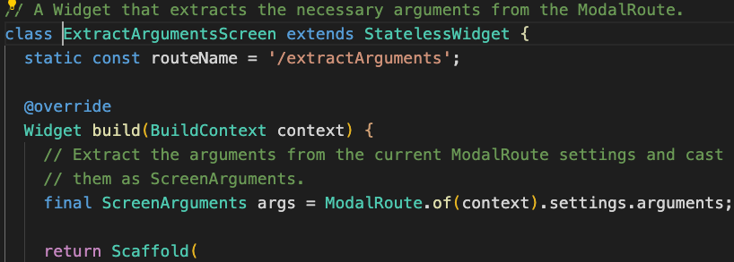
Clase para almacenar los argumentos y definir el widget que extrará los argumentos
Notes:
Code:
class MyApp extends StatelessWidget {
@override
Widget build(BuildContext context) {
return MaterialApp(
title: 'Navigation with Arguments',
home: HomeScreen(),
routes: {
ExtractArgumentsScreen.routeName: (context) =>
ExtractArgumentsScreen(),
});
}
}
class HomeScreen extends StatelessWidget {
@override
Widget build(BuildContext context) {
return Scaffold(
appBar: AppBar(
title: Text('Home Screen'),
),
body: Center(
child: Column(
mainAxisAlignment: MainAxisAlignment.center,
children: <Widget>[
// A button that navigates to a named route that. The named route
// extracts the arguments by itself.
ElevatedButton(
child: Text("Navigate"),
onPressed: () {
// When the user taps the button, navigate to a named route
// and provide the arguments as an optional parameter.
Navigator.pushNamed(
context,
ExtractArgumentsScreen.routeName,
arguments: ScreenArguments(
'Extract Arguments Screen',
'This message is extracted in the build method.',
),
);
},
),
],
),
),
);
}
}
// A Widget that extracts the necessary arguments from the ModalRoute.
class ExtractArgumentsScreen extends StatelessWidget {
static const routeName = '/extractArguments';
@override
Widget build(BuildContext context) {
// Extract the arguments from the current ModalRoute settings and cast
// them as ScreenArguments.
final ScreenArguments args = ModalRoute.of(context).settings.arguments;
return Scaffold(
appBar: AppBar(
title: Text(args.title),
),
body: Center(
child: Text(args.message),
),
);
}
}
// You can pass any object to the arguments parameter. In this example,
// create a class that contains both a customizable title and message.
class ScreenArguments {
final String title;
final String message;
ScreenArguments(this.title, this.message);
}

Slide 9
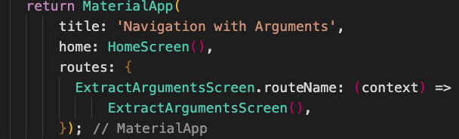
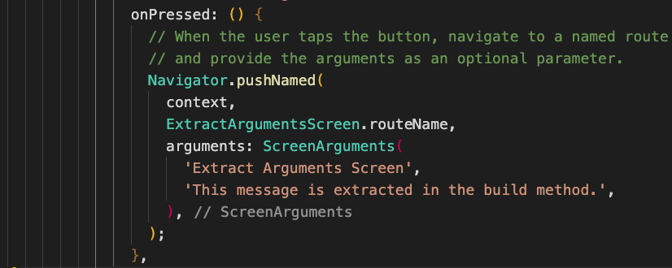
Definición de la ruta y uso de la ruta

Slide 10
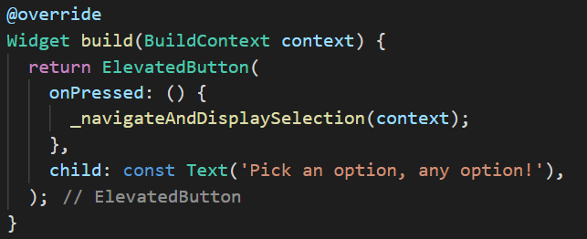
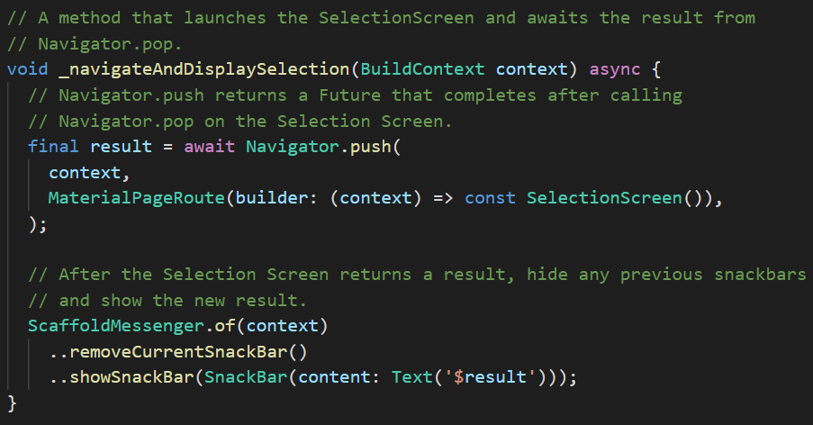
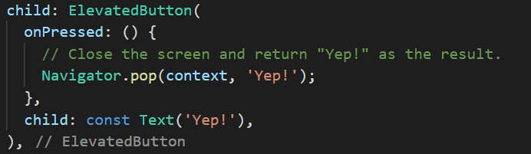
Recuperar información de ventanas
Botón que invoca el método
Botón que cierra la ventana y retorna un dato
Método que invoca la ventana, espera por el retorno de un dato y lo publica en un SnackBar

Slide 11
Ejercicio en clase
Calculadora de Factorial
1!
2!
3!
4!
El resultado es: 24
24
2
3
1
12
4
24
X!
=
+
=
+
=
+
=
+

Slide 12
Enlaces a Github Classroom y al repositorio
https://classroom.github.com/a/vWF_wToe
https://github.com/pedrowightman/navegacionFlutter

